Slide 1

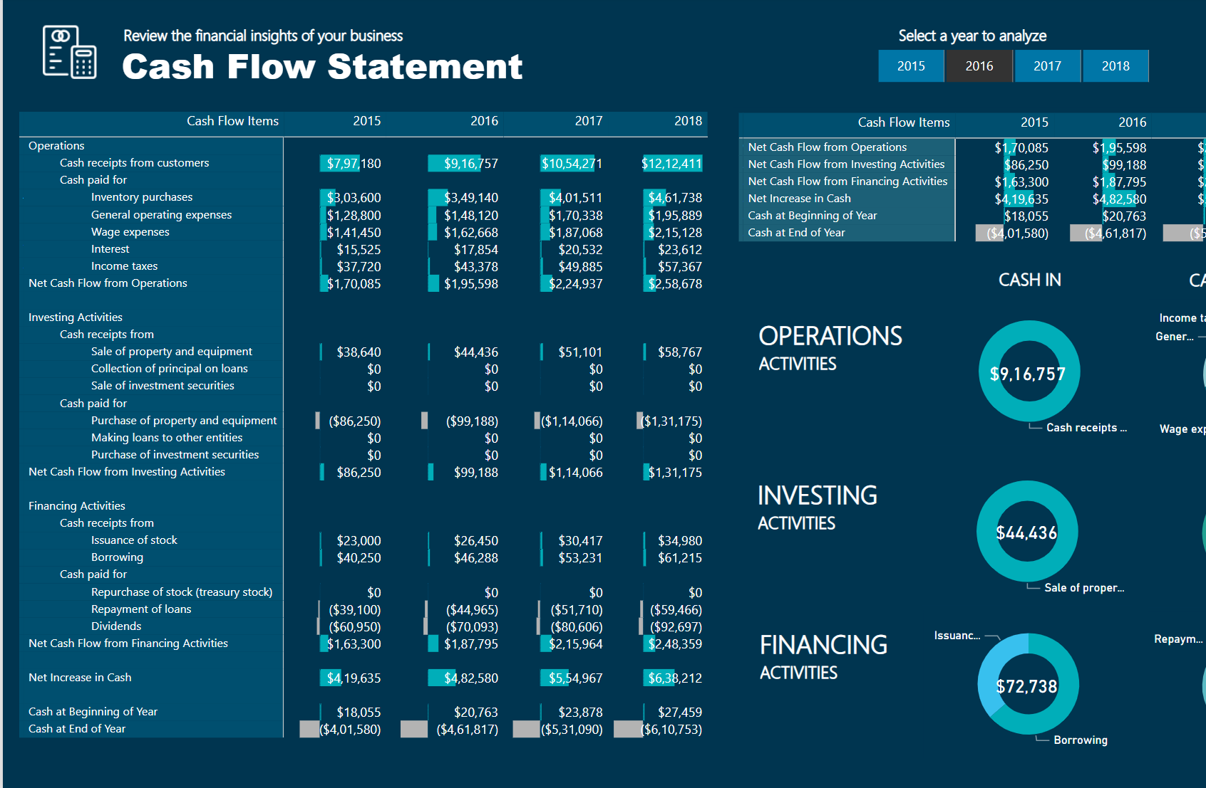
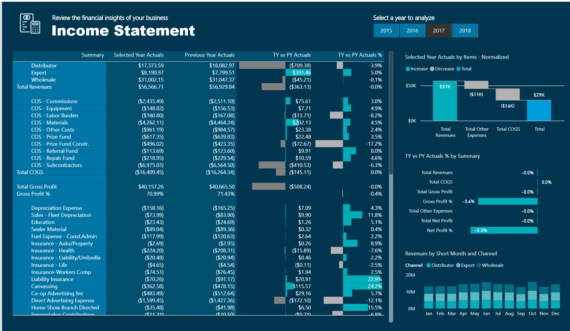
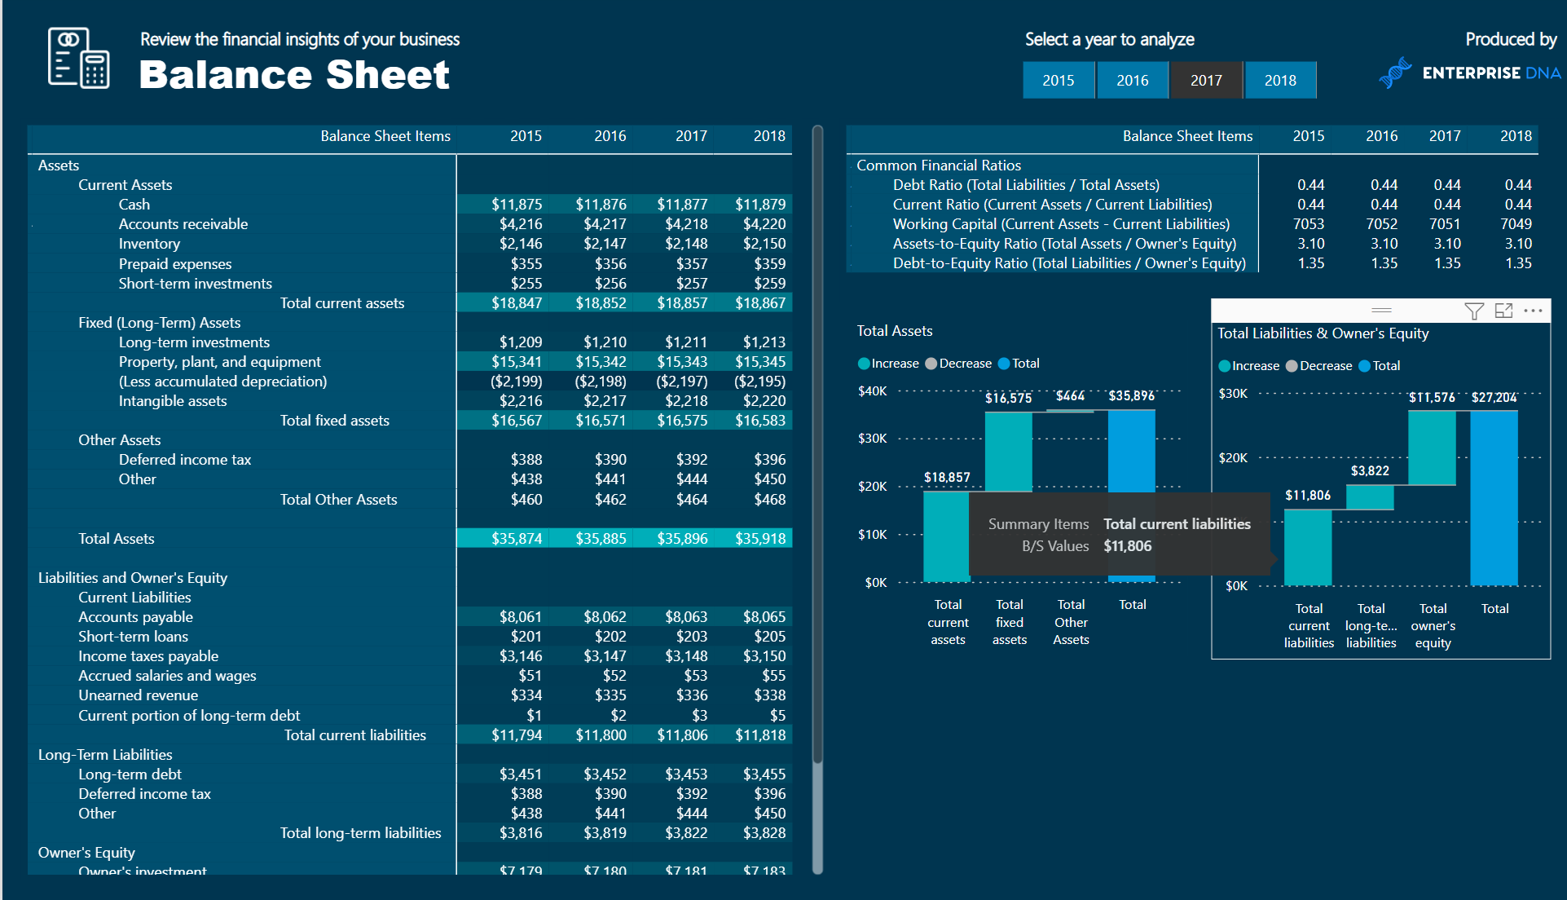
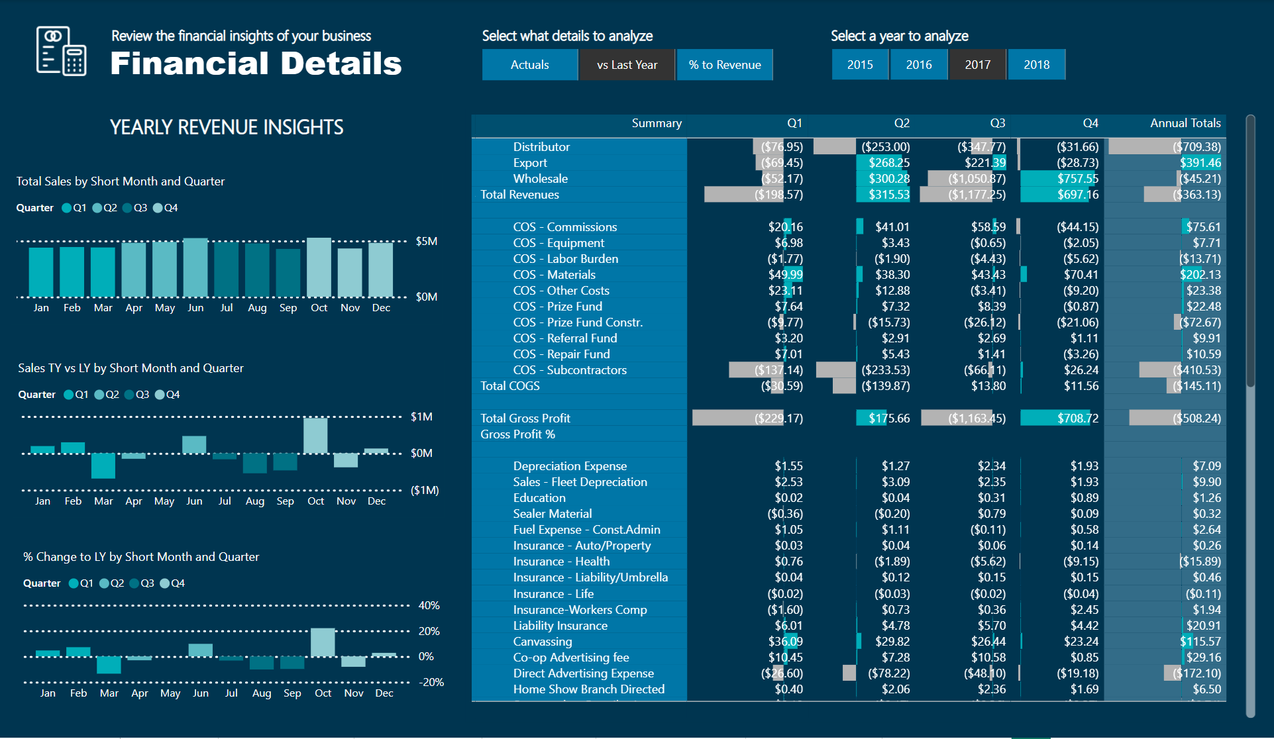


Financial Reporting In Power BI
View in Power BI
Last data refresh:
5/14/2024 5:28:08 PM UTC
Downloaded at:
5/14/2024 5:29:50 PM UTC

Slide 2
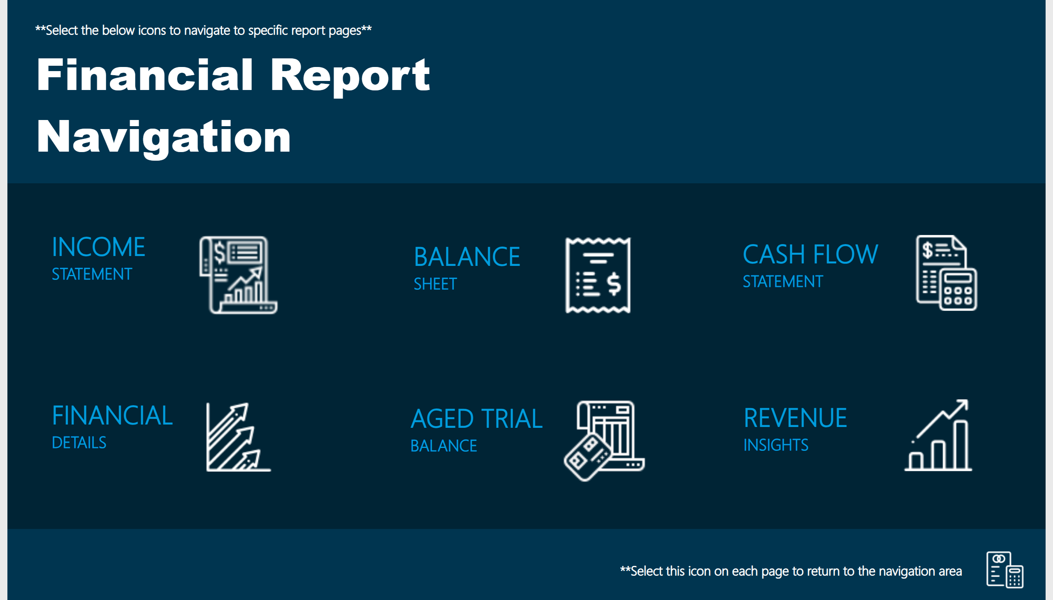
Navigation
Notes:
textbox
No alt text provided
textbox
No alt text provided
textbox
No alt text provided
textbox
No alt text provided
textbox
No alt text provided
textbox
No alt text provided
textbox
No alt text provided
textbox
No alt text provided
textbox
No alt text provided
image
No alt text provided
image
No alt text provided
image
No alt text provided
image
No alt text provided
image
No alt text provided
image
No alt text provided
image
No alt text provided
basicShape
No alt text provided

Slide 3
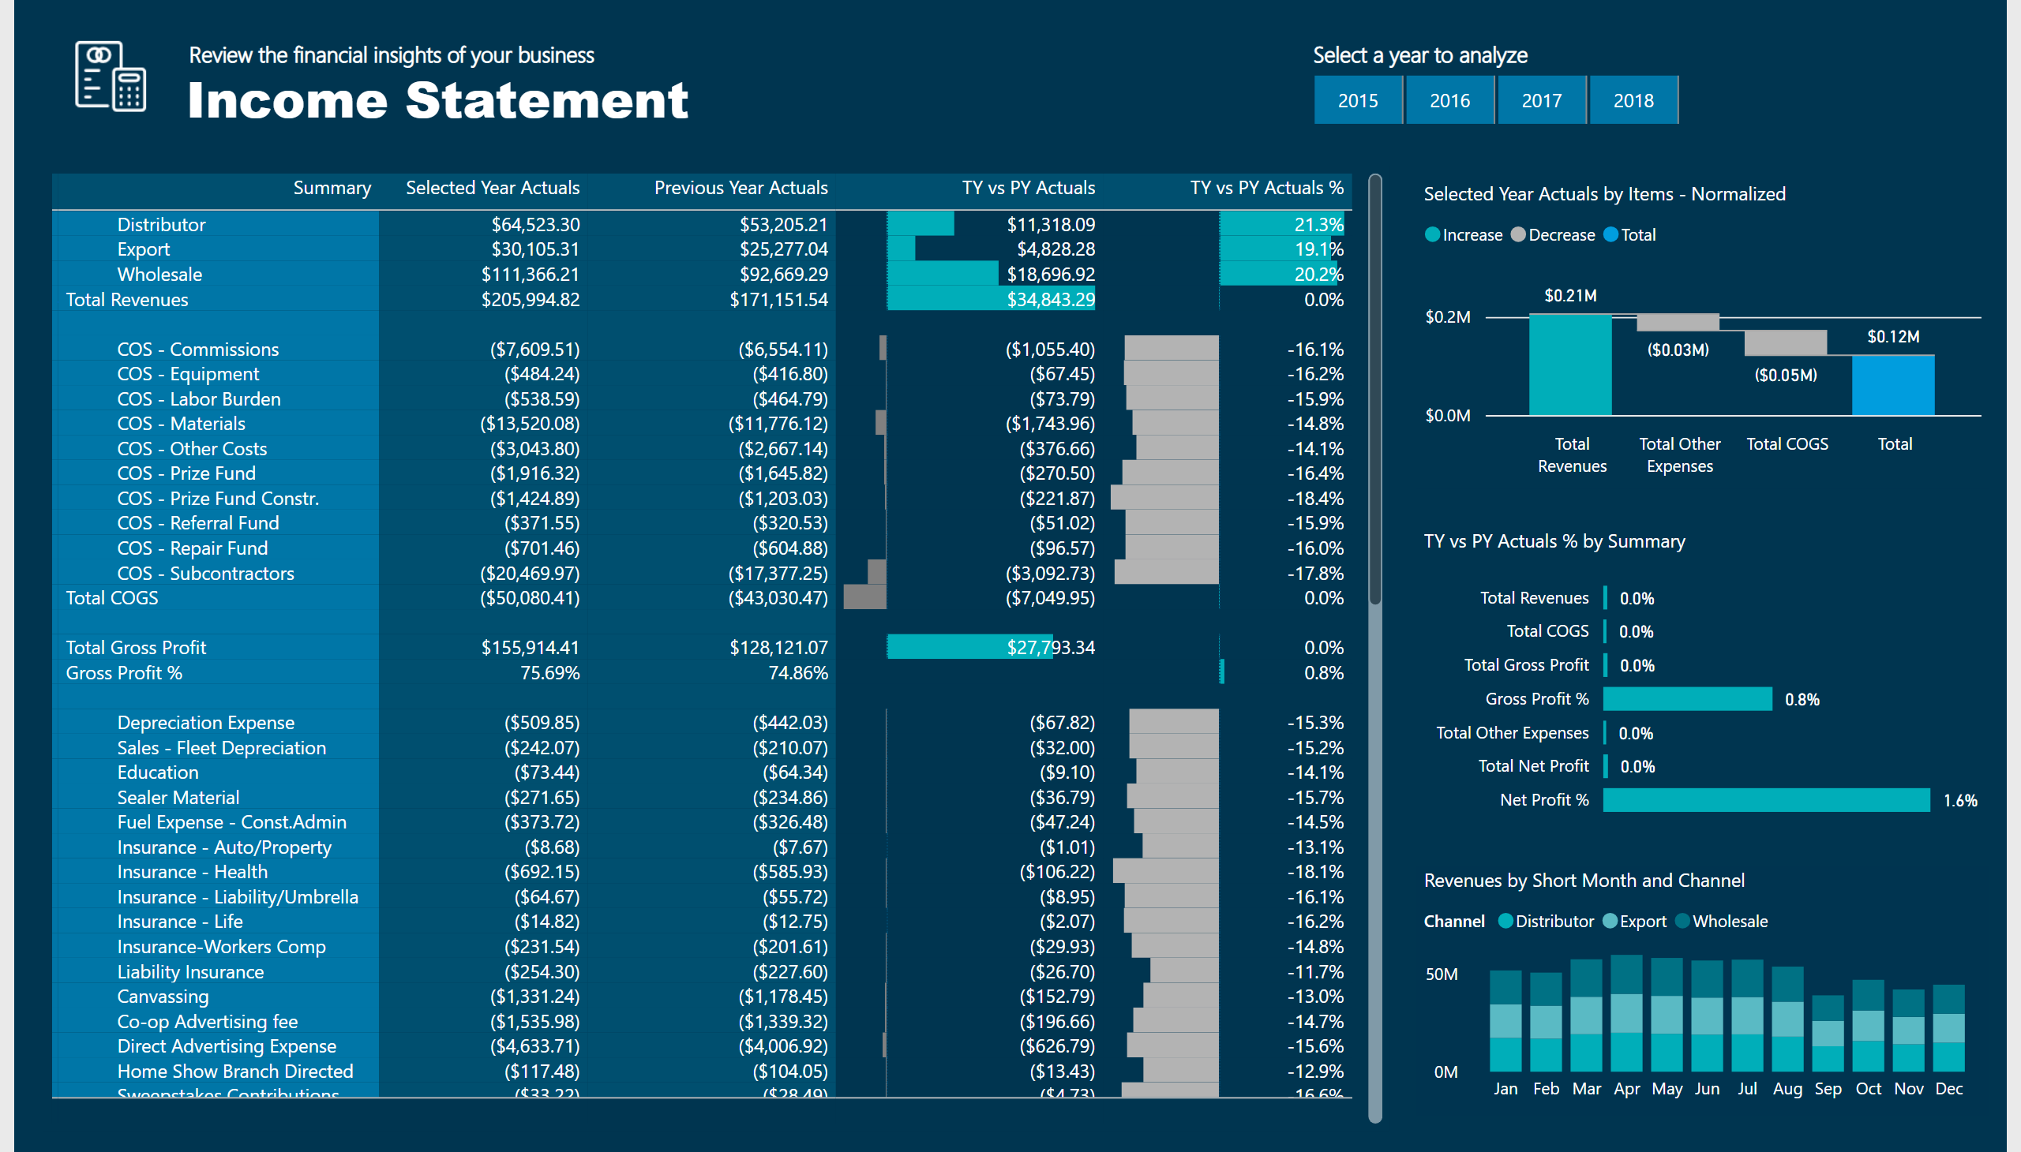
Income Statement
Notes:
slicer
No alt text provided
textbox
No alt text provided
tableEx
No alt text provided
image
No alt text provided
textbox
No alt text provided
textbox
No alt text provided
waterfallChart
No alt text provided
barChart
No alt text provided
columnChart
No alt text provided

Slide 4
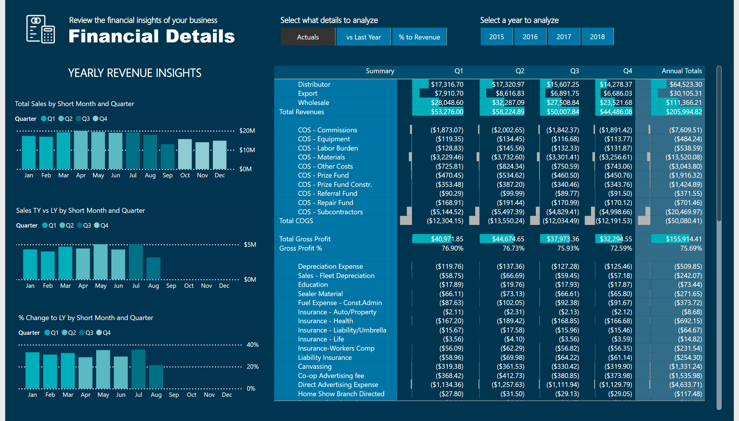
Financial Details
Notes:
slicer
No alt text provided
textbox
No alt text provided
image
No alt text provided
textbox
No alt text provided
textbox
No alt text provided
tableEx
No alt text provided
slicer
No alt text provided
textbox
No alt text provided
columnChart
No alt text provided
columnChart
No alt text provided
columnChart
No alt text provided
textbox
No alt text provided

Slide 5
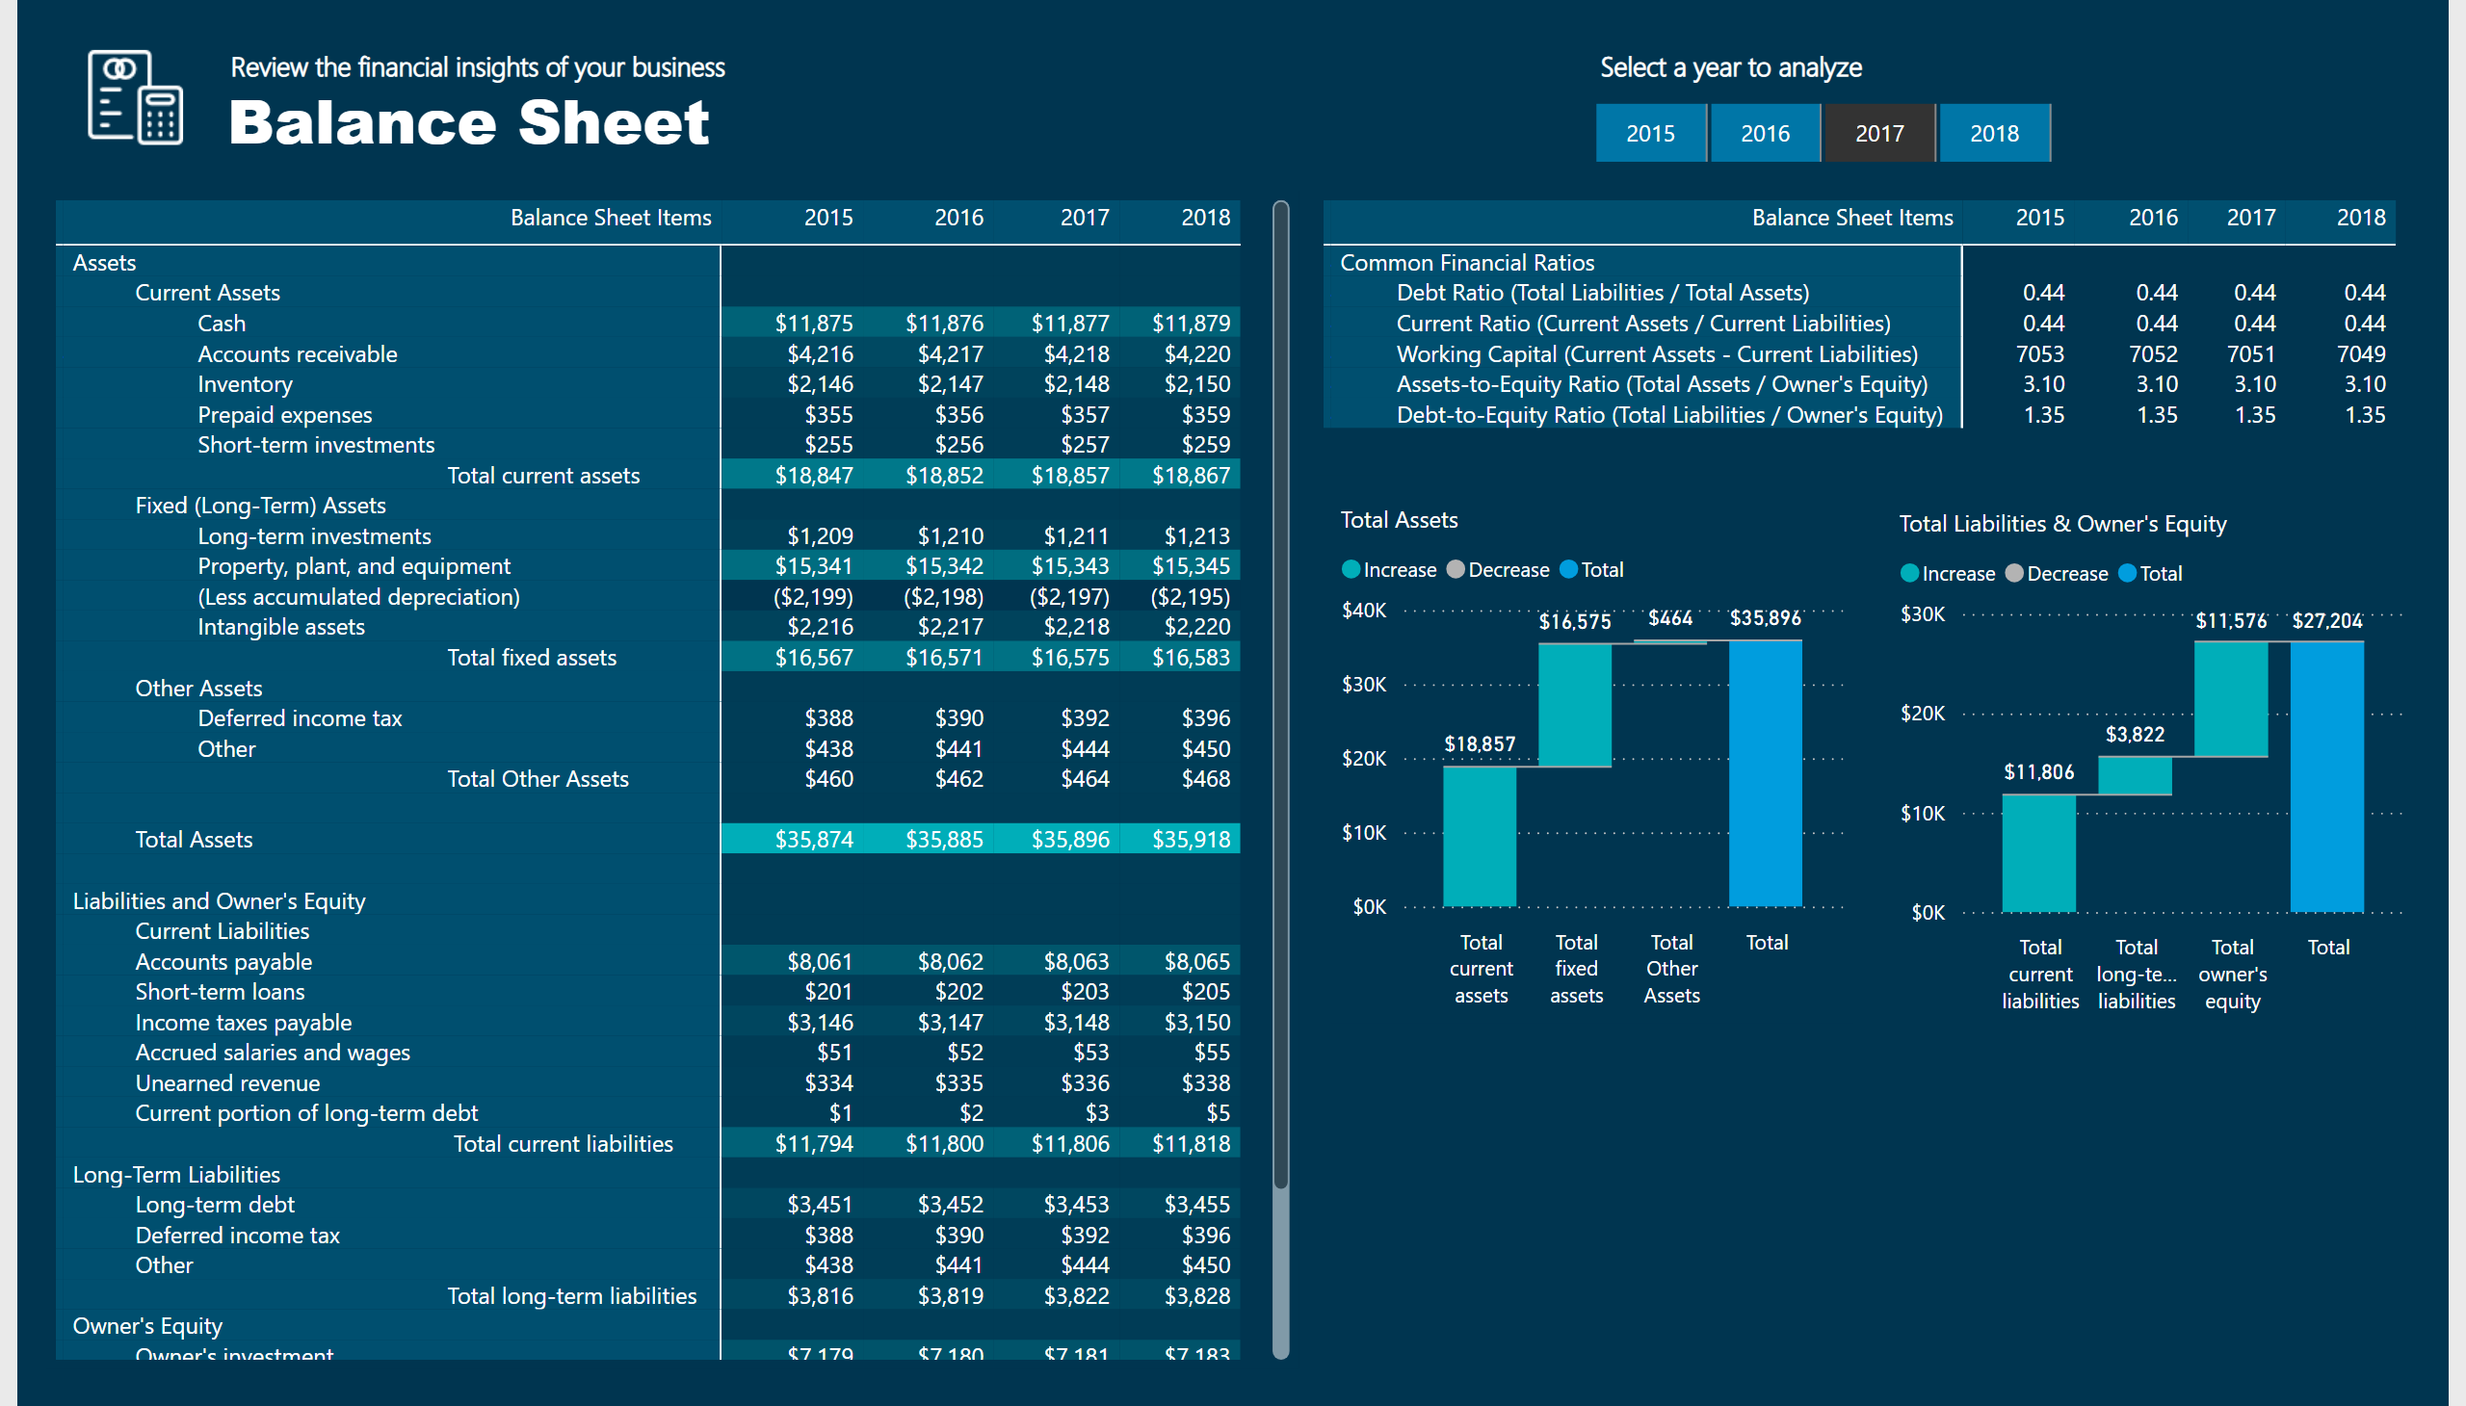
Balance Sheet
Notes:
textbox
No alt text provided
textbox
No alt text provided
image
No alt text provided
slicer
No alt text provided
textbox
No alt text provided
pivotTable
No alt text provided
pivotTable
No alt text provided
Total Assets
No alt text provided
Total Liabilities & Owner's Equity
No alt text provided

Slide 6
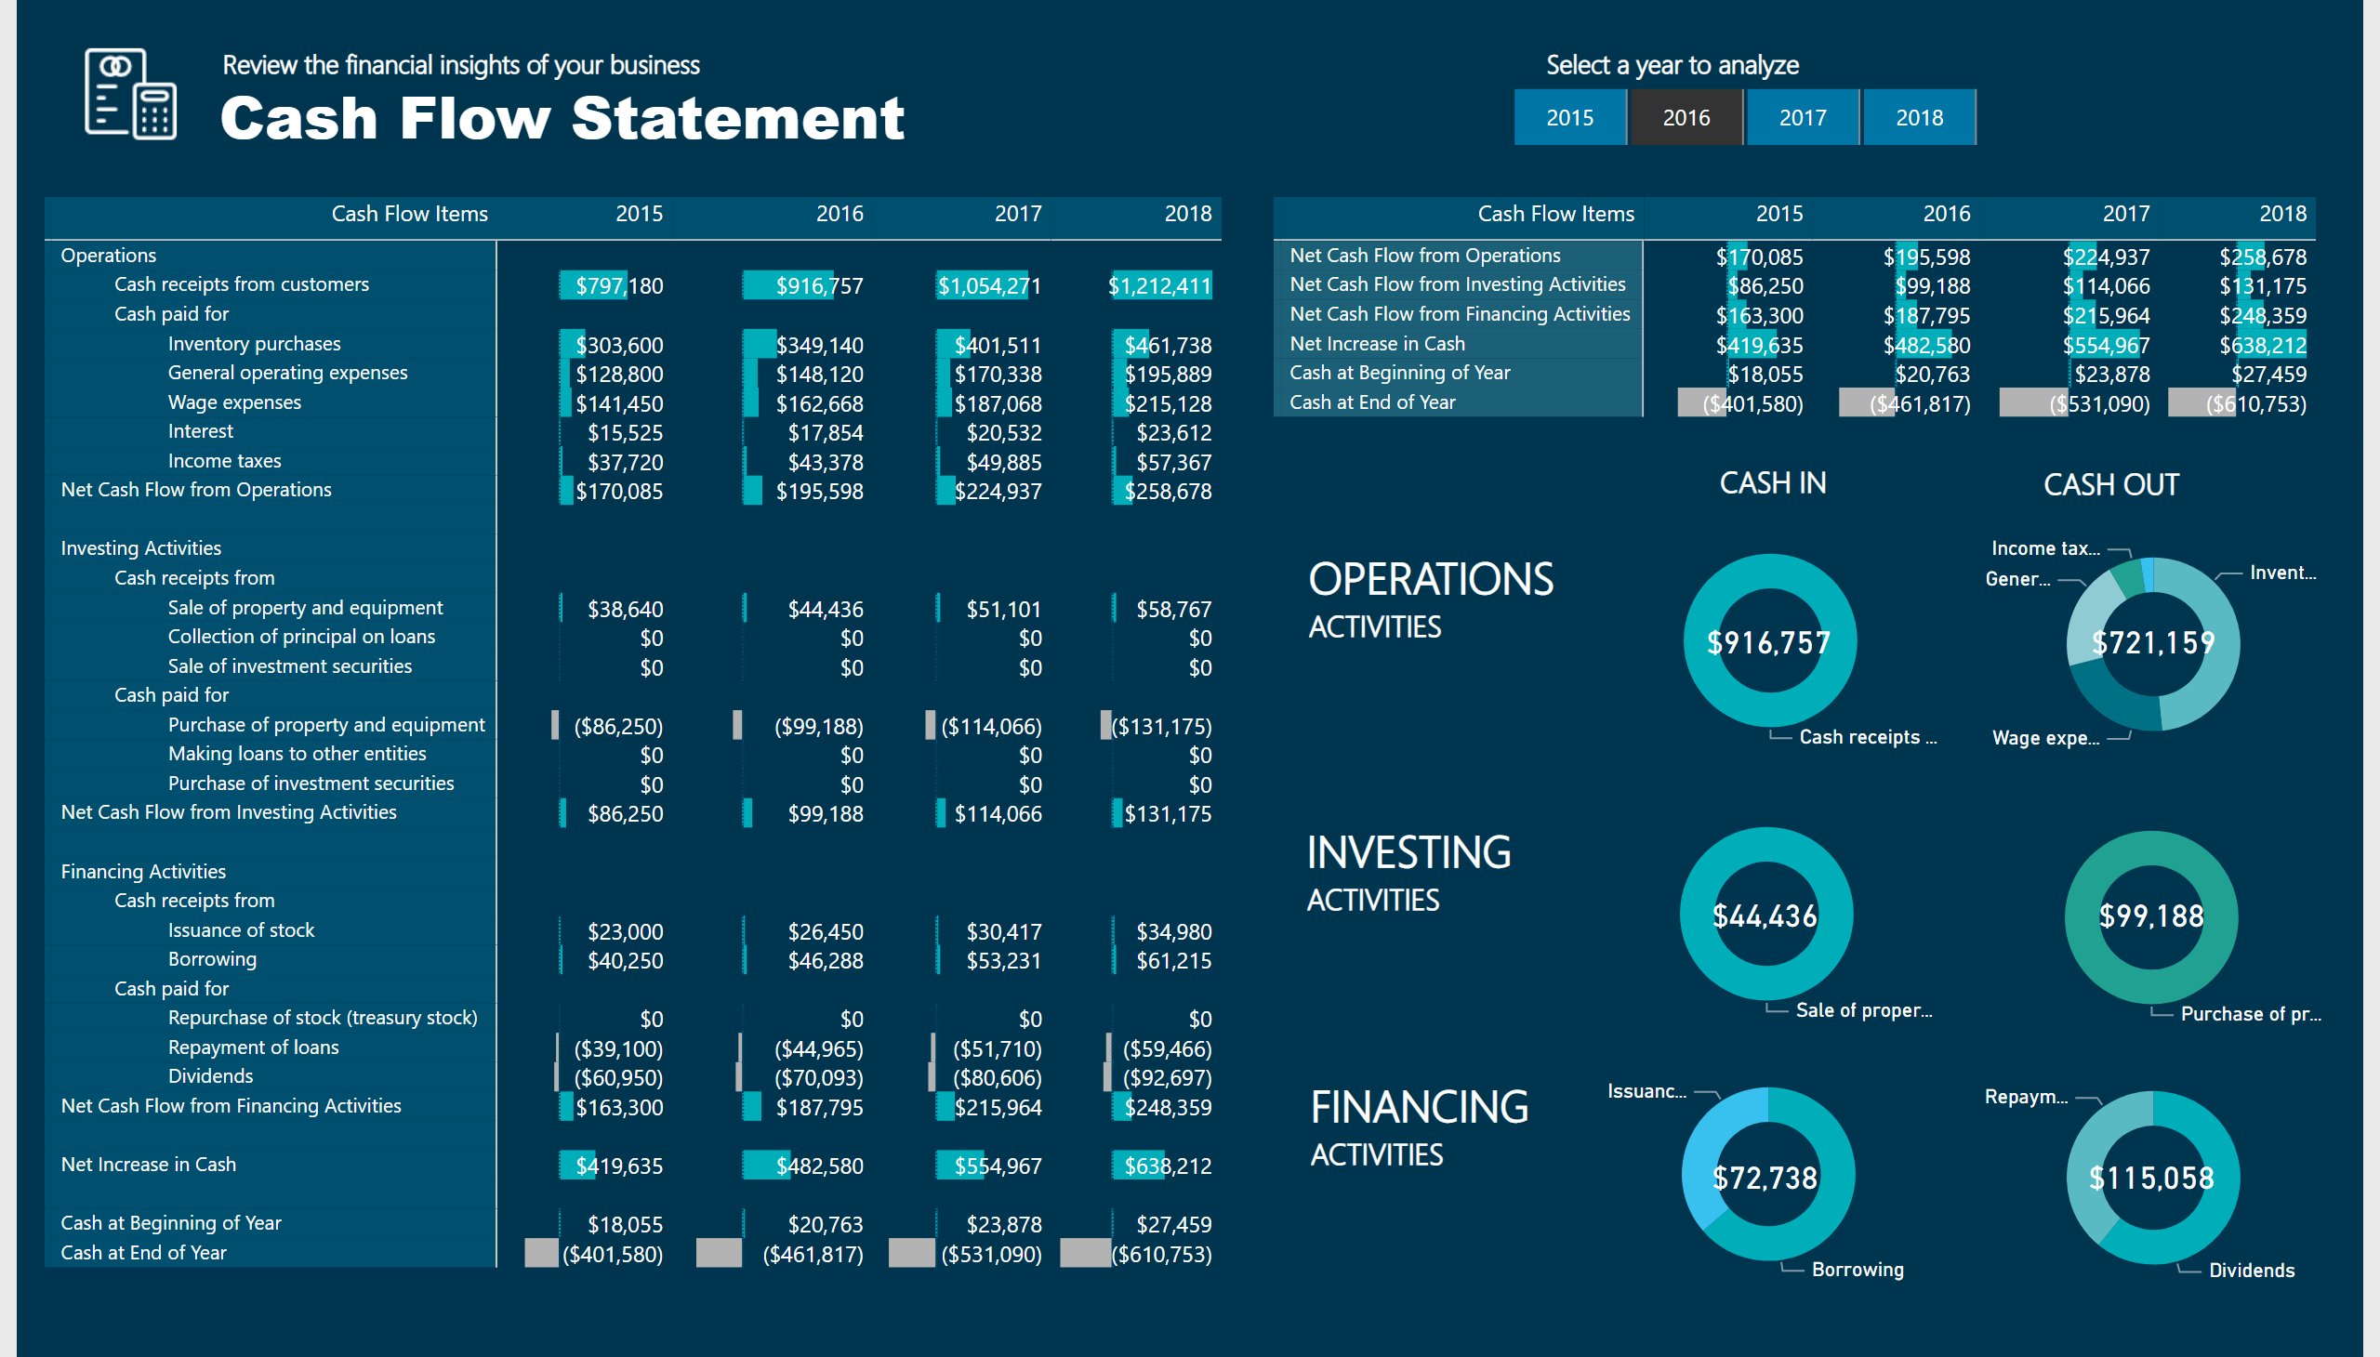
Cash Flow Statement
Notes:
textbox
No alt text provided
textbox
No alt text provided
image
No alt text provided
slicer
No alt text provided
textbox
No alt text provided
pivotTable
No alt text provided
pivotTable
No alt text provided
textbox
No alt text provided
textbox
No alt text provided
textbox
No alt text provided
donutChart
No alt text provided
textbox
No alt text provided
textbox
No alt text provided
donutChart
No alt text provided
card
No alt text provided
card
No alt text provided
donutChart
No alt text provided
donutChart
No alt text provided
donutChart
No alt text provided
donutChart
No alt text provided
card
No alt text provided
card
No alt text provided
card
No alt text provided
card
No alt text provided

Slide 7
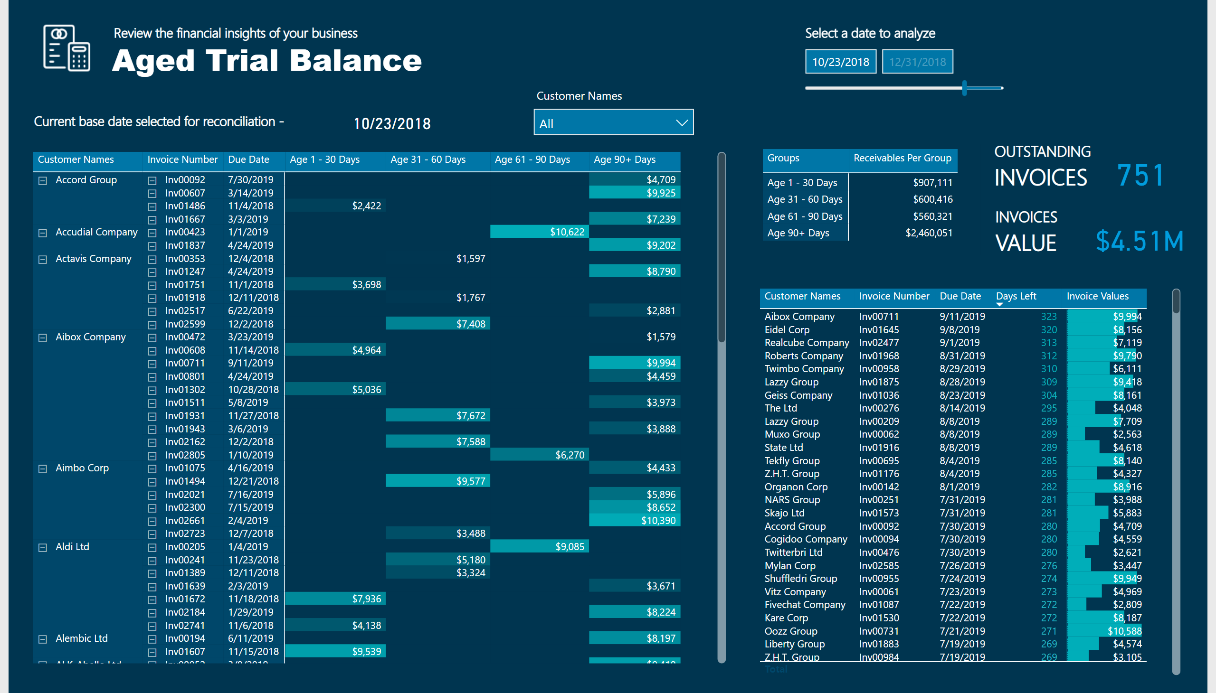
Aged Trial Balance
Notes:
image
No alt text provided
textbox
No alt text provided
textbox
No alt text provided
pivotTable
No alt text provided
slicer
No alt text provided
card
No alt text provided
textbox
No alt text provided
textbox
No alt text provided
slicer
No alt text provided
card
No alt text provided
tableEx
No alt text provided
pivotTable
No alt text provided
card
No alt text provided
textbox
No alt text provided
textbox
No alt text provided

Slide 8
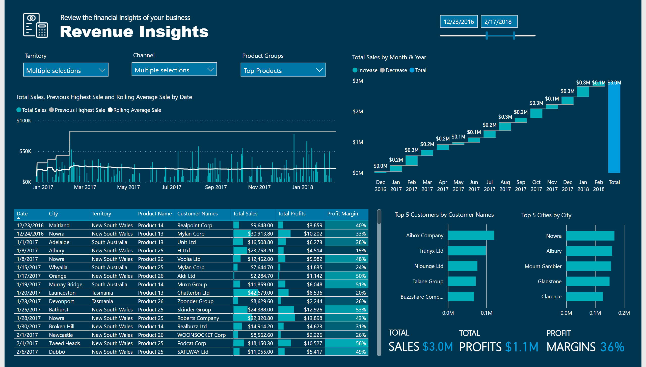
Revenue Insights
Notes:
textbox
No alt text provided
textbox
No alt text provided
image
No alt text provided
lineStackedColumnComboChart
No alt text provided
waterfallChart
No alt text provided
tableEx
No alt text provided
slicer
No alt text provided
slicer
No alt text provided
slicer
No alt text provided
slicer
No alt text provided
barChart
No alt text provided
barChart
No alt text provided
card
No alt text provided
card
No alt text provided
textbox
No alt text provided
textbox
No alt text provided
textbox
No alt text provided
card
No alt text provided

